Slide 1
PUFFER :A Routability-Driven Placement Framework via Cell Padding
Zhengtao Wu
Shanghai LEDA Technology Co., Ltd.,
Shanghai 201203, China
Zhijie Cai, Peng Zou, Xingyu Tong, Jun Yu, Jianli Chen
State Key Lab of ASIC & System
Fudan University, Shanghai 200433, China
Yao-Wen Chang
Department of Electrical Engineering
National Taiwan University, Taipei 10617, Taiwan
Presenter : Min-Feng Hsieh
Adviser : Ting-Chi Wang

Slide 2
Outline
Abstract
Introduction
Preliminaries
Proposed Algorithm
Experimental Result
Conclusion

Slide 3
Outline
Abstract
Introduction
Preliminaries
Proposed Partitioning Framework For Multi-GPU Acceleration
Experimental Result
Conclusion

Slide 4
Abstract
Estimate the congestion by imitating routing detour and clustered cell spreading.
Use the method of cell padding and strategy exploration for optimizing routibility during global placement and legalization stage.
Cell padding considers multiple features, which accumulating accurate congestion.
Apply Bayesian-based method to avoid parameter tuning.
PUFFER achieves best routability with 2.7x(commercial) and 1.4x(Replace) speedups.
Notes:
Placement is critical for the routability optimization.

Slide 5
Outline
Abstract
Introduction
Preliminaries
Proposed Partitioning Framework For Multi-GPU Acceleration
Experimental Result
Conclusion

Slide 6
Introduction
Routability-driven placement typically consists of:
Basic placement engine: Quadratic placement, non-linear placement.
Routability optimizer.
Notes:
In quadratic placement, an iterative framework with lower and upper bounds is often applied. The lower bound is described by a quadratic wirelength model to minimize wirelength, and the upper bound is generated by spreading cells in high density regions to remove cell overlaps
In non-linear placement, the objective function is formulated by a non-linear wirelength model subject to a density constraint. By relaxing the density constraint into the objective function, the placement problem can be solved by gradient-descent-based methods to obtain a high-quality placement solution with the desired tradeoff between wirelength and cell density.

Slide 7

Preliminaries
Routability-driven Placement Problem
H= (V, E), where V= $\{v_{1}, v_{2}, …, v_{n}\}$, E= $\{e_{1}, e_{2}, …, e_{m}\}$.
The placement solution= (x, y)= $(x_{1}, …, x_{n}, y_{1}, …, y_{n})$, where ($x_{i}, y_{i}$) is the coordinate of $cell_{i}$.

Slide 8

Preliminaries
We can formulate analytical global routing problem as:
$$\underset{(x, y)}{\min{f\left(x\right)=}}{W\left(x, y\right)+ λD(x, y)}$$
$W\left(x, y\right):$wirelength.
$D\left(x, y\right):$ Density penalty to spread cells.
λ : Density penalty factor
Notes:
Λ : to balance the weight between wirelength and density
After doing global routing, we need to legalize the cell positions to remove cell overlaps
and DRC violations.

Slide 9
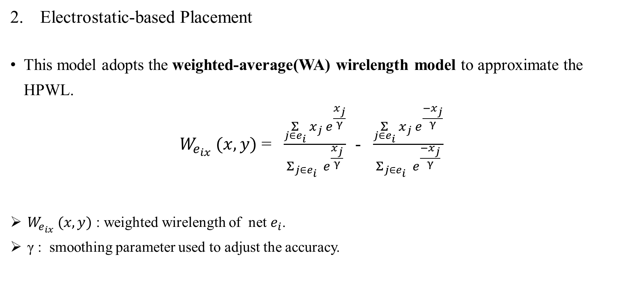

Preliminaries
$${W_{e_{i}} (x, y){ = W}_{e_{ix}} (x, y) +W}_{e_{iy}} (x, y)$$
Electrostatic-based Placement
This model adopts the weighted-average(WA) wirelength model to approximate the HPWL.
$W_{e_{ix}} (x, y)$ = $\frac{\underset{j∈e_{i}}{Σ}{x_{j}{ e}^{\frac{x_{j}}{γ}}}}{Σ_{j∈e_{i}}{{ e}^{\frac{x_{j}}{γ}}}}$ - $\frac{\underset{j∈e_{i}}{Σ}{x_{j}{ e}^{\frac{{−x}_{j}}{γ}}}}{Σ_{j∈e_{i}}{{ e}^{\frac{{−x}_{j}}{γ}}}}$
$W_{e_{ix}} (x, y)$ : weighted wirelength of net $e_{i}$.
γ : smoothing parameter used to adjust the accuracy.
Notes:
Electrostatic: 靜電
$W_{e_{i}} (x, y):$ weighted wirelength of net ei
Γ: smoothing parameter used to adjust the accuracy.

Slide 10

Preliminaries
To get the density penalty, the placement region will first divide into uniform bins by M×M grids.
$$D\left(x, y\right)= \underset{v_{i}∈V,{ v}_{i}∈b_{m,n}}{Σ}{w_{i}h_{i}ψ(m,n)}$$
${ w}_{i}h_{i}$: area of cell I
${ b}_{m,n}$: the bin in row m and column n
$ψ(m,n$) : the electric potential of $b_{m,n}$

Slide 11
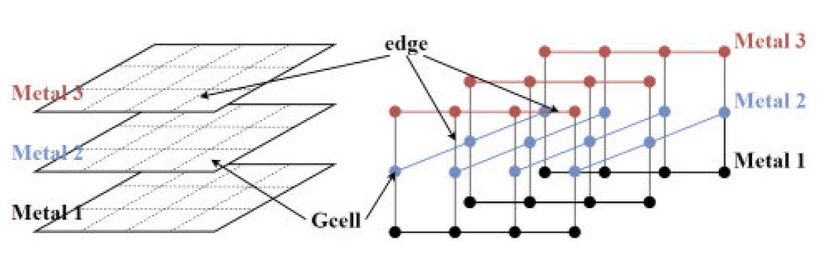
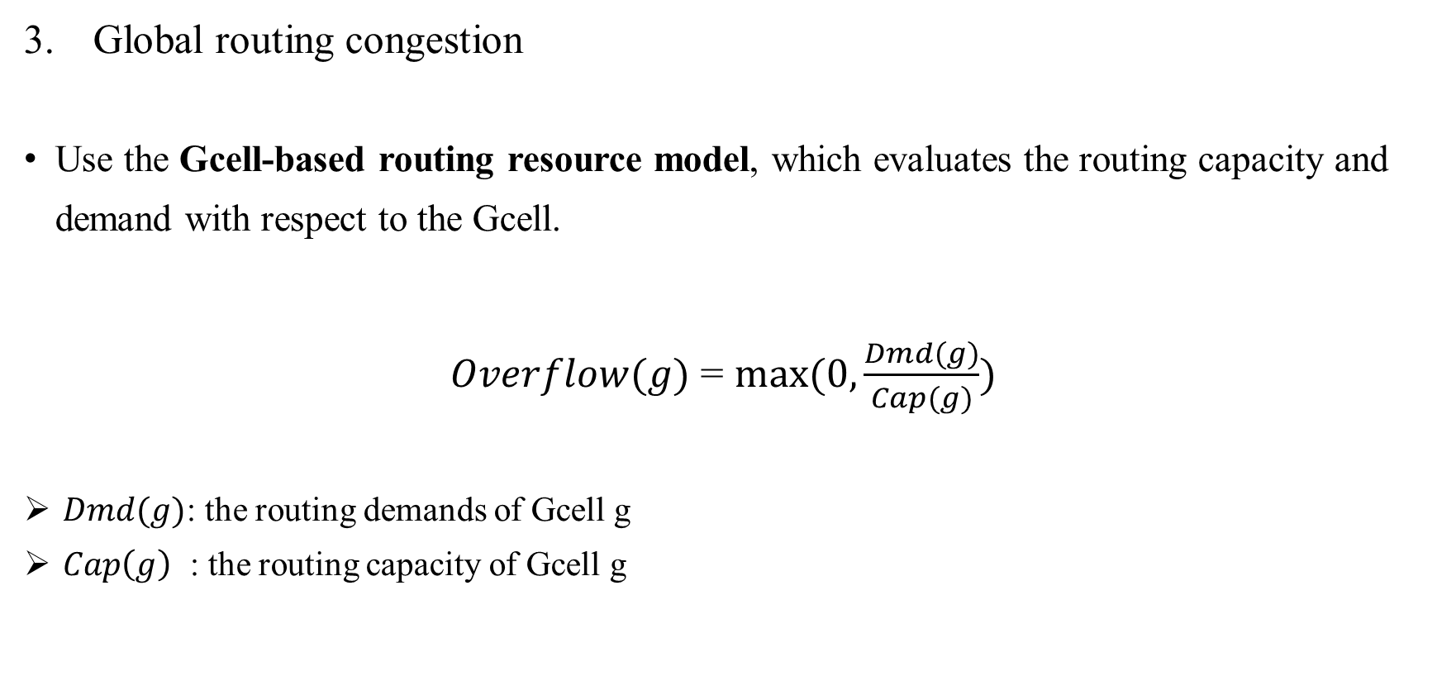
Preliminaries
Global routing congestion
Use the Gcell-based routing resource model, which evaluates the routing capacity and demand with respect to the Gcell.
$Overflow(g)$ = $max⁡(0, \frac{Dmd(g)}{Cap(g)})$
$Dmd(g)$: the routing demands of Gcell g
$Cap\left(g\right)$ : the routing capacity of Gcell g

Slide 12
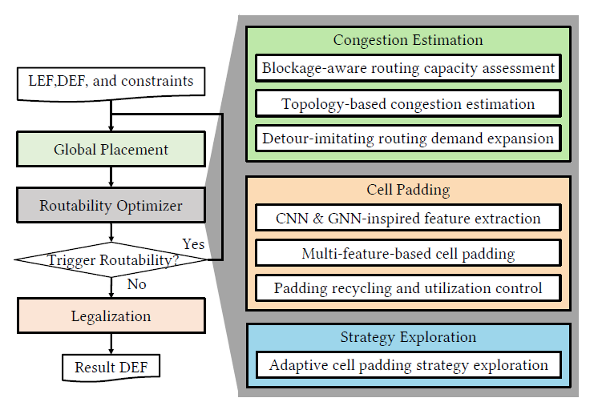
Proposed Algorithm

Slide 13
Routing-detour-imitation-based Congestion Estimation
Blockage-aware Routing Capacity Assessment
To get the capacity map.
Routing capacity includes 1. basic capacity and 2. blocked capacity.
Basic capacity: obtain from tech information (wire width and space).
Blocked capacity: includes pin obstructions, power ground, macros…
${Cap}_{H/V}(g)$ = $\sum_{l.pd=H/V}^{l∈L}{\frac{{GcellLength}_{H/V}}{{MetalWidth}_{l}+ {WireSpacing}_{l}}} − \sum_{b∈Blk}{\frac{{OL}_{H/V} (b,g)}{{MetalWidth}_{b.l}+ {WireSpacing}_{b.l}}}$
Notes:
CapH=V (g) : the horizontal or vertical routing capacity of Gcell g
l.pd : the preferred routing direction of metal layer l
L : the set of metal layers
Blk : the set of blockages
OLH=V (b; g) is the horizontal or vertical overlaps between blockage b and Gcell g
b.l : the metal layer where the obstacle is located

Slide 14
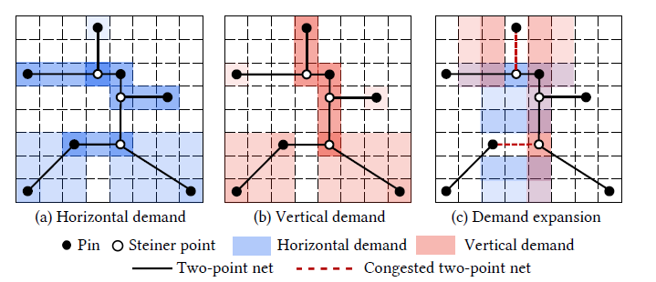
Routing-detour-imitation-based Congestion Estimation
Topology-based Congestion Estimation
To estimate the routing demand of all nets.
Use FLUTE to get the RSMT topology of the nets.

Slide 15
Routing-detour-imitation-based Congestion Estimation
Detour-imitating Routing Demand Expansion

Slide 16
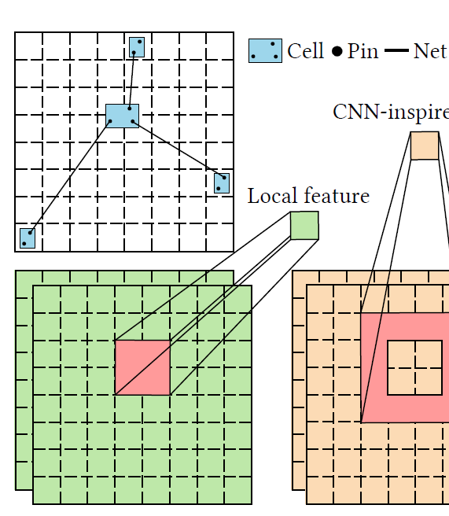

Multi-feature-based Cell Padding
CNN and GNN-inspired feature extraction
Traditional local information
$LCg\left(c\right)$ = $\max_{gεPos(c)}{Cg(g)}$
$LCg\left(c\right)$: the local congestion of cell c
$Cg(g$): the congestion of Gcell g
Notes:
LCg(c) is the local congestion of cell c
Pos(c) is the Gcell set including all Gcells overlapped with cell c
Cg(g) is the congestion of Gcell g
Cg H/V (g) : horizontal and vertical congestion
Pin density could be calculated by the number of cell pins in each Gcell divided by the number of available sites in each Gcell.

Slide 17
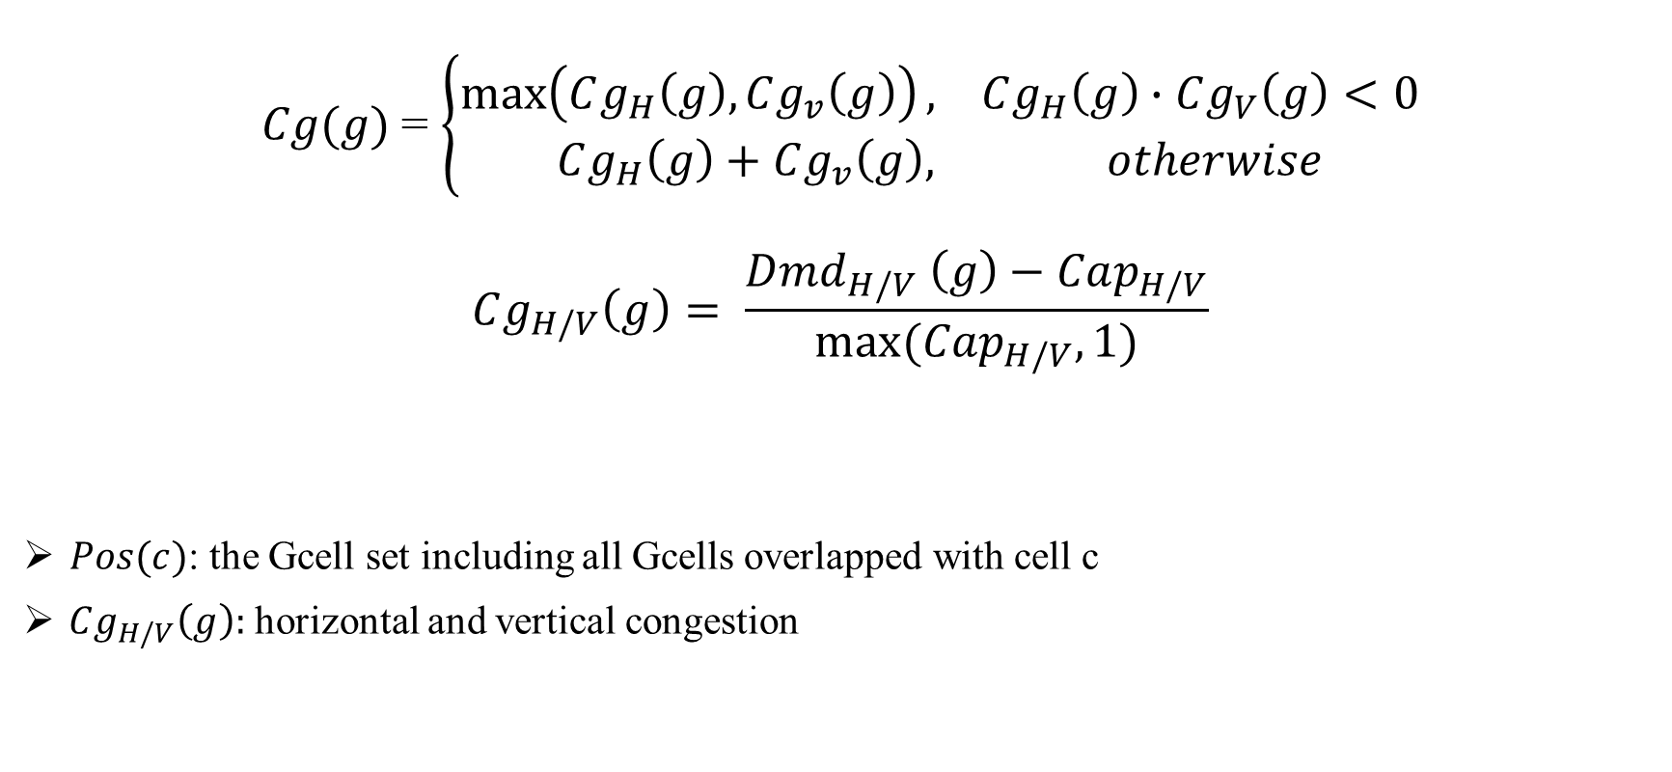
Multi-feature-based Cell Padding
$Cg(g)$= $\left\{\begin{aligned}\max\left(Cg_{H}\left(g\right), Cg_{v}\left(g\right)\right), Cg_{H}\left(g\right)∙Cg_{V}\left(g\right)<0 \\ Cg_{H}\left(g\right)+Cg_{v}\left(g\right), otherwise\end{aligned}\right.$
$$Cg_{H/V}\left(g\right)= \frac{Dmd_{H/V} \left(g\right)−Cap_{H/V}}{max⁡(Cap_{H/V},1)}$$
$Pos(c)$: the Gcell set including all Gcells overlapped with cell c
$Cg_{H/V}\left(g\right):$horizontal and vertical congestion
Notes:
LCg(c) is the local congestion of cell c
Pos(c) is the Gcell set including all Gcells overlapped with cell c
Cg(g) is the congestion of Gcell g
Cg H/V (g) : horizontal and vertical congestion
Pin density could be calculated by the number of cell pins in each Gcell divided by the number of available sites in each Gcell.

Slide 18
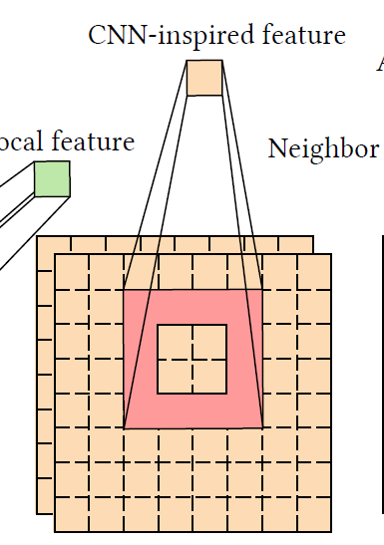
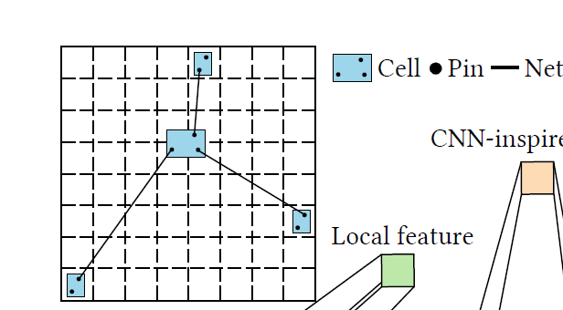
Multi-feature-based Cell Padding
Surrounding congestion and surrounding pin density (CNN)
To expand a cell’s bounding box vertically and horizontally.
The size of the expanded bounding box equals to the convolution kernel size.
The kernel does the mean filter operation.

Slide 19
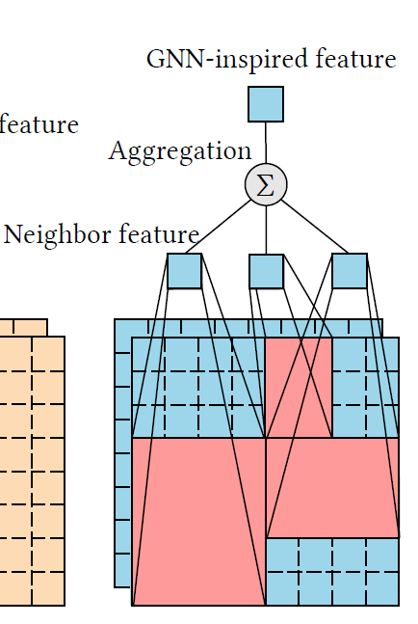
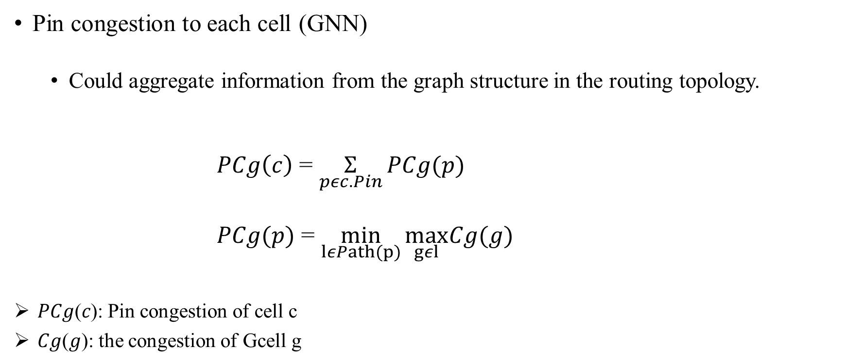
Multi-feature-based Cell Padding
Pin congestion to each cell (GNN)
Could aggregate information from the graph structure in the routing topology.
$PCg\left(c\right)$ = $\underset{pεc.Pin}{Σ}{PCg(p)}$
$PCg(p)$ = $\min_{lεPath(p)}{\max_{gεl}Cg(g)}$
𝑃𝐶𝑔(𝑐): Pin congestion of cell c
𝐶𝑔(𝑔): the congestion of Gcell g

Slide 20
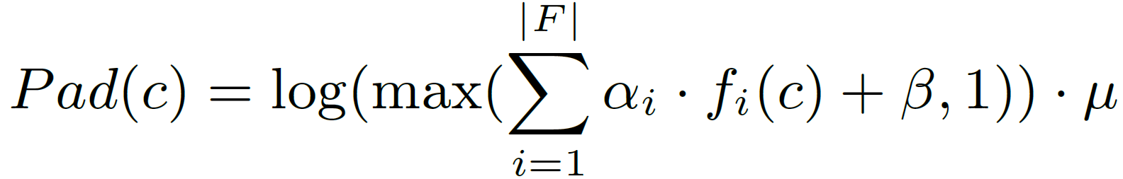

Multi-feature-based Cell Padding
Multi-feature-based Cell Padding
After collecting all the required features, we can calculate the expected padding value.
${\text{α}}_{i}$: the weight of the $i$th feature $f_{i}$
β and μ: the strategy parameter
F: the set of features
Notes:
The logarithmic function intends to smooth the distribution of padding values, which could improve the stability of the padding process.

Slide 21
Multi-feature-based Cell Padding
Padding Recycling and Utilization Control
Utilize incremental padding strategy which is based on the preceding result.

Slide 22
Thank you for listening!

